Slide 1

Notes:
raul

Slide 2
Data sources
 | Electronidex | Blackwell Products
Time range | 1 month | Unknown (<1 year) We assume: 1 month
Total volume of sold products | 43,328 | 47,776
Number of distinct products | 125 | 74 current 24 potential new

Slide 3

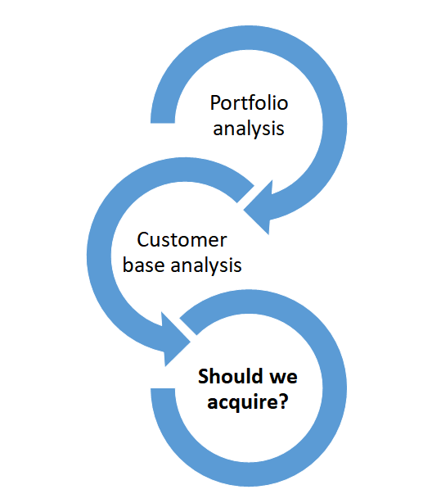

Slide 4
Option A → Acquiring
Option B → Internal growth
*adding new products to the current portfolio
Notes:
if we do not acquire…..

Slide 5
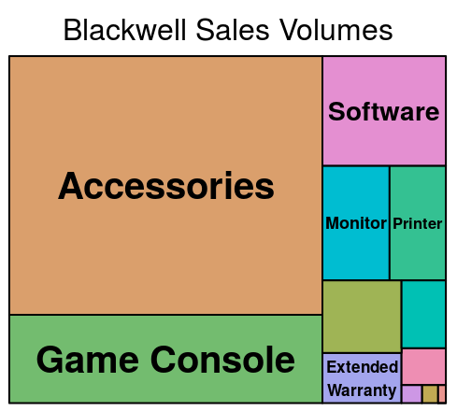
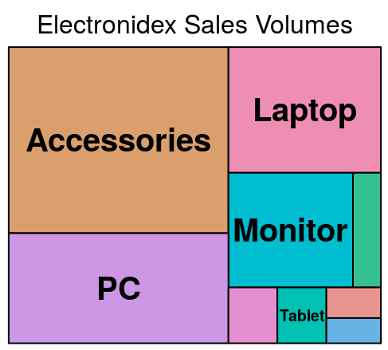

Portfolios and brands are complementary
Analysis of Best Sellers in Both Portfolios
Blackwell
Electronidex
Notes:
analysis of Best-sellers in both portfolios

Slide 6


Electronidex customer base adds value to ours!
Analysis of Electronidex Customer Base
B2B
B2C
Gamers
Apple lovers
Blackwell’s B2C customer base
Notes:
analysis of Electronidex customer base to see if it would add value yo ours
we don’t have evidence that Blackwell has B2B clients

Slide 7
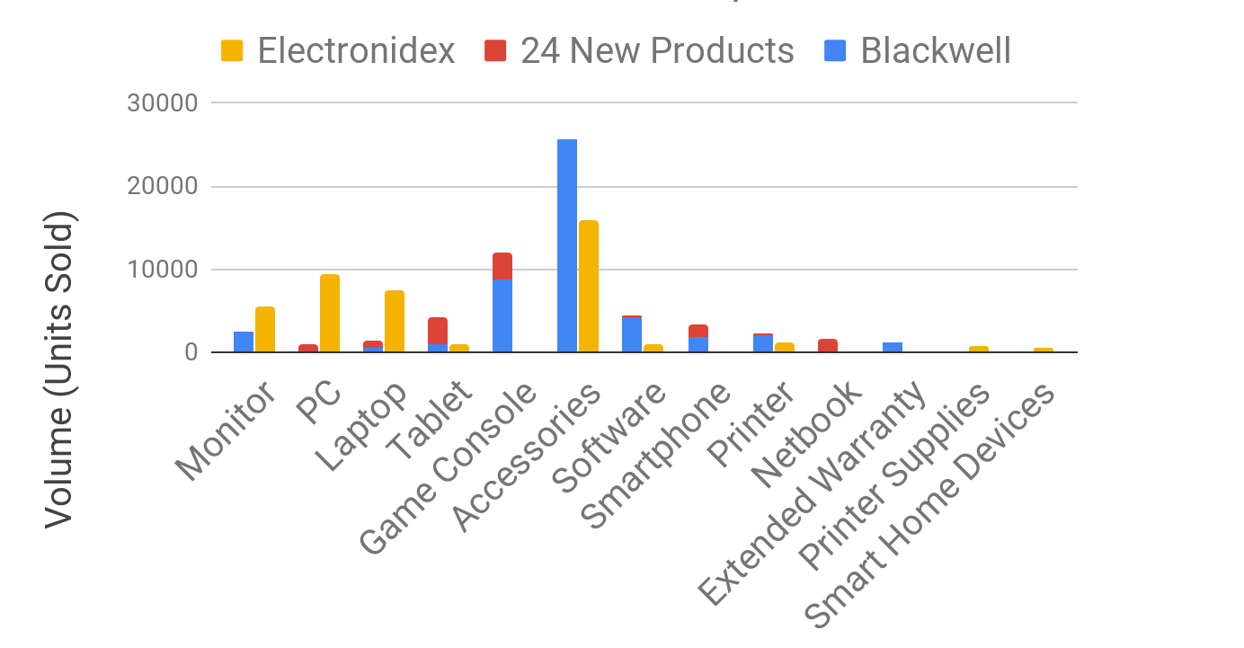
Acquisition is key to increase sales volume efficiently
Sales volume comparison between growth strategies
Notes:
Accessories most sold category by Blackwell
acquisition would lead to an increase in sales in powerful categories such as monitors, pcs and laptops

Slide 8



How do volumes relate to profit?
Blackwell Sales Volumes
Profit by Category
Game Consoles
PCs
Software
Monitors
Printers
5 Tablets
1 Monitors
2 Game Consoles
3 Warranties
Accessories
4 Smart-
phones
Accessories
Although Accessories is our top sales category, it has low profit.
Notes:
Here’s our sales volumes again, and our top five by volume
But are these our most profitable categories?
No, here are the top five categories by profit they bring.
Volume of each block
Accessories
PCs

Slide 9
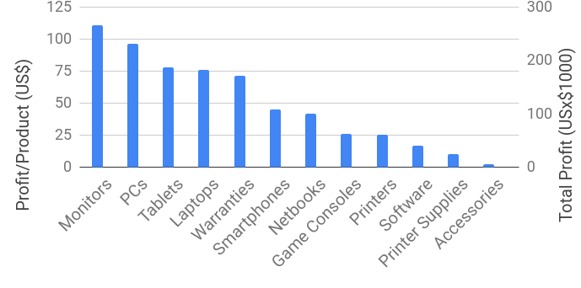
Are we selling enough high-profit items?
Blackwell - Average Profit / Product by Category
High leverage categories

Slide 10
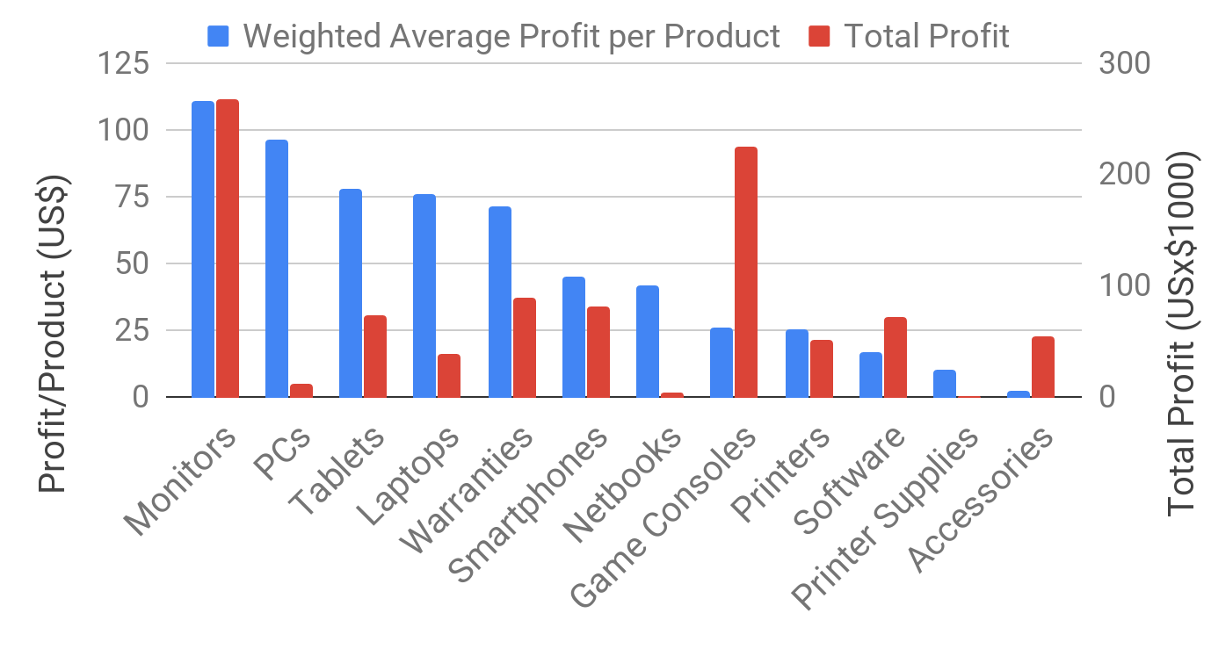
Are we selling enough high-profit items?
Blackwell - Average Profit / Product by Category
We need to improve sales of PCs, Tablets and Laptops
Electronidex excels in these categories

Slide 11
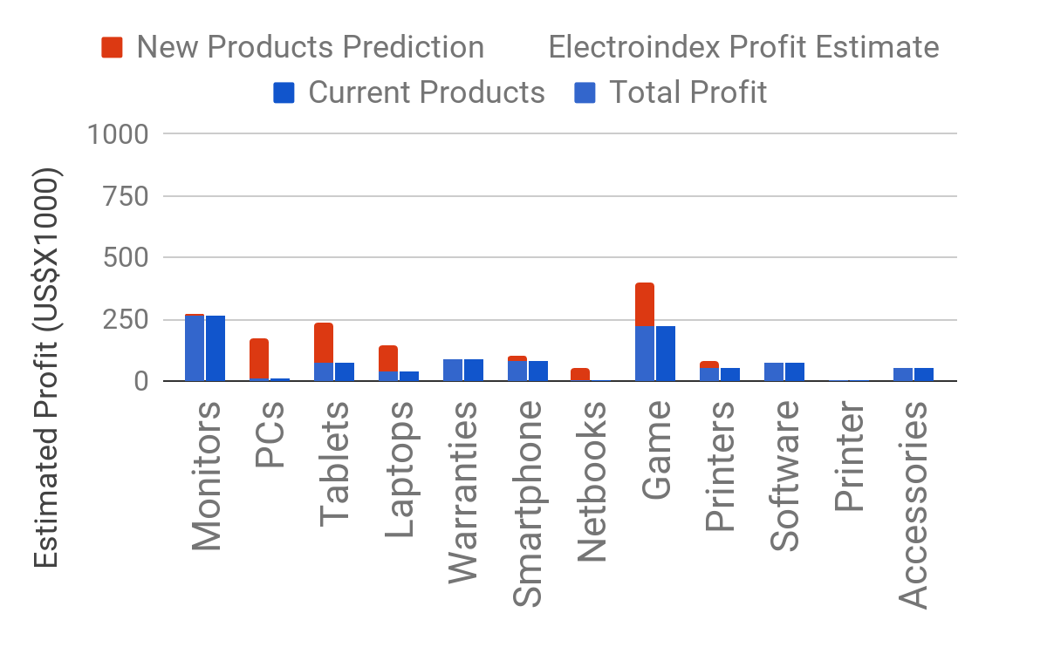
If we grow internally adding 24 new products...
Current and Predicted Profit
Some of our product categories could double in profit

Slide 12
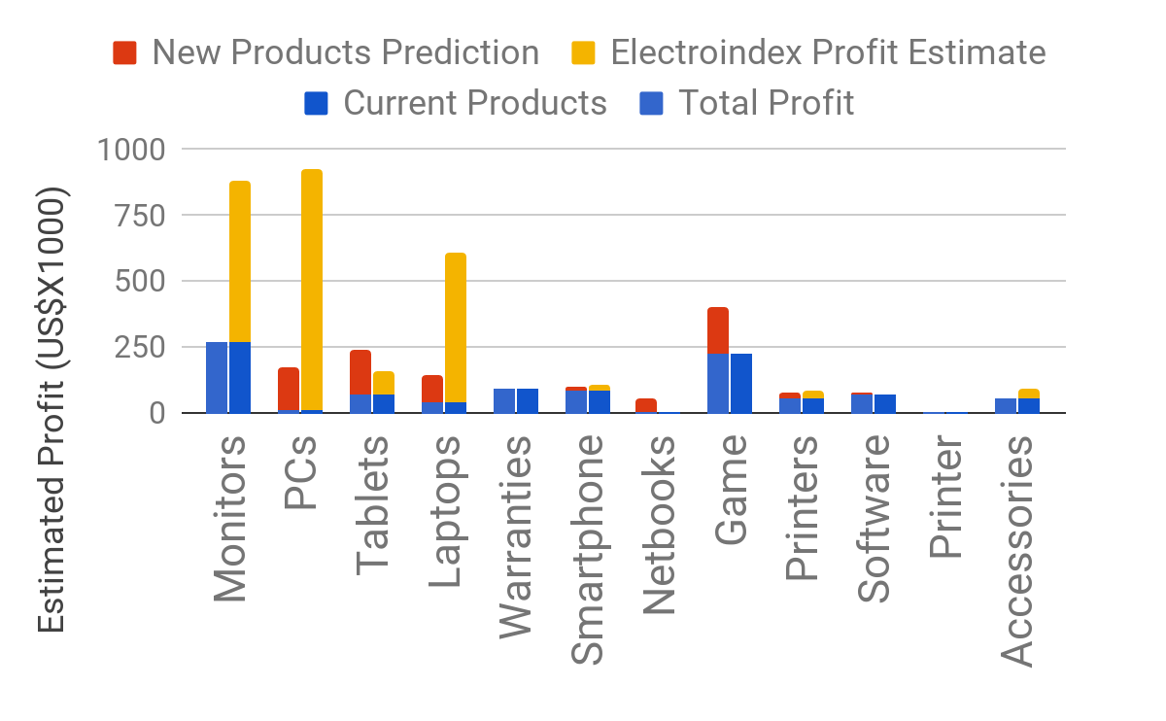
If we acquire Electronidex...
Current and Predicted Profit
But…
We don’t know Electronidex’s real profit margins
Cannibalism
Electronidex is strong where we want to be stronger!
Notes:
Limitations: We don’t know Electronidex’s actual profit margins, they could be much lower than ours
Estimates do not take into account cannibalism between our products and theirs

Slide 13
Electronidex Sales Patterns
Percentage of time monitor is purchased with this combination
Basket
Desktop, Software, Keyboard
Monitor
75%
Desktop, Software, Computer Mice
Monitor
74%
Desktop,Laptop, Keyboard, Mouse and Keyboard Combo
Monitor
73%
Monitors are a great cross-selling products.

Slide 14
Key-findings
Both brands portfolios are complementary
Electronidex customer base adds value to ours; B2B clients
Monitors & PCs have the highest positive influence in profitability → cross-selling potential
Acquisition is the key to grow efficiently
Notes:
cross-selling? acer/sony? b2b b2c?

Slide 15
Future Applications of Data Mining at Blackwell
Heavy metals and carcinogens
Notes:
Long fruitful life?
Laptop?
There’s a lot of things in life that might matter more to us than increasing profits or sales.
Electronics recycling

Slide 16

Agbobloshie, Ghana

Slide 17


Future Applications of Data Mining at Blackwell
Heavy metals and carcinogens
Explosion of electronics in the past decades
Are we a part of the problem or the solution?
Create a recycling program because it’s the right thing to do.
BestBuy has recycling. They report some of their best customers are recyclers. (2015)
Blackwell can use similar data mining to see effects on business, such as customer retention
Let’s be a part of the solution!
Notes:
Long fruitful life?
Laptop?
There’s a lot of things in life that might matter more to us than increasing profits or sales.
Electronics recycling

Slide 18
Thank you!

